Slide 1



Object Detection Module Project
Name: Akmal Ali
Registration No: GLT-DSAI-249

Slide 2


Introduction
In this group project, we set out to develop an object detection model for classifying various road conditions and turns in images captured in Gilgit, Baltistan. Our primary objective was to enable the model to identify right turns, left turns, straight roads, and unexpected conditions like landslides. This project involved hands-on experience with data collection, labeling, and model training, leveraging the YOLOv8 (You Only Look Once) framework.

Slide 3
Data Collection and Labeling:
We collected a total of 337 images from various locations in Gilgit, including Sultanabad, Jutial, and Danyore. These images were divided into a training set (70%), test set (20%), and validation set (10%). The data was meticulously labeled using Roboflow into five distinct classes: Landslides, Left-Turn, Other, Right-Turn, and Straight-Road.

Slide 4
Model Training and Implementation
The model training was conducted using the YOLOv8 framework with a pre-trained YOLOv8 small model (yolov8s.pt).
The training process involved several stages:
1. Environment Setup: We configured our training environment, installed dependencies, and prepared the GPU for training.
2. Pre-trained Model: The YOLOv8 small pre-trained model was chosen to accelerate training and improve model accuracy
3. Dataset Configuration: Our data was organized into training, validation, and test sets. Each set was used for specific phases of training to ensure unbiased performance assessment.
4. Model Training: Training was conducted over 50 epochs with a batch size of 16 and an image size of 224x224. A learning rate of 0.01 was initially set, with further adjustments to prevent overfitting and ensure convergence.

Slide 5
Results and Evaluation
The YOLOv8 model yielded promising results, accurately detecting and classifying road conditions and turns. Evaluation metrics revealed high precision and recall, indicating effective model performance.

Slide 6
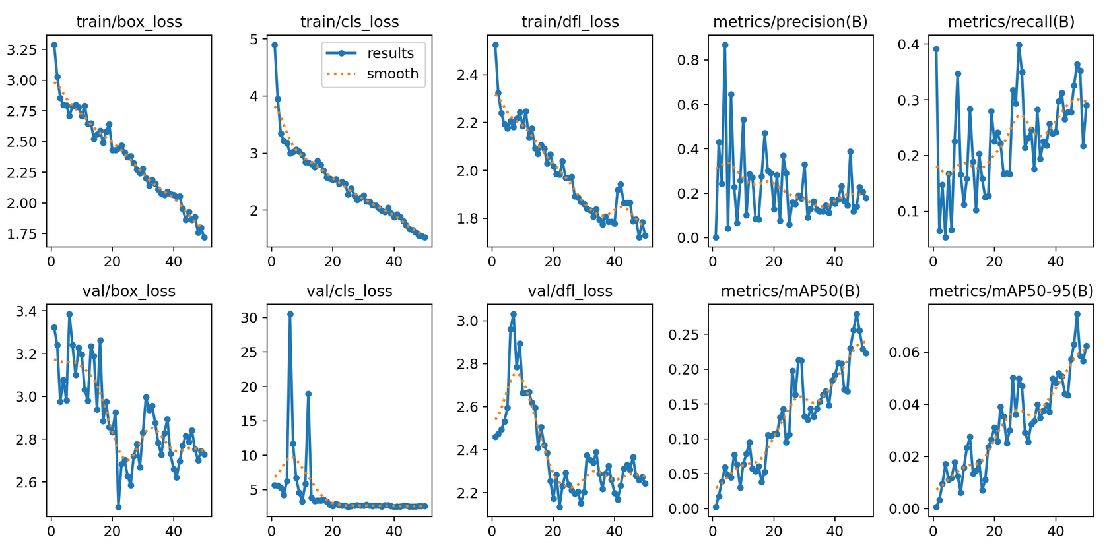
Model Performance
This analysis covers the key training and validation metrics observed during the training of our YOLO-based object detection model.

Slide 7
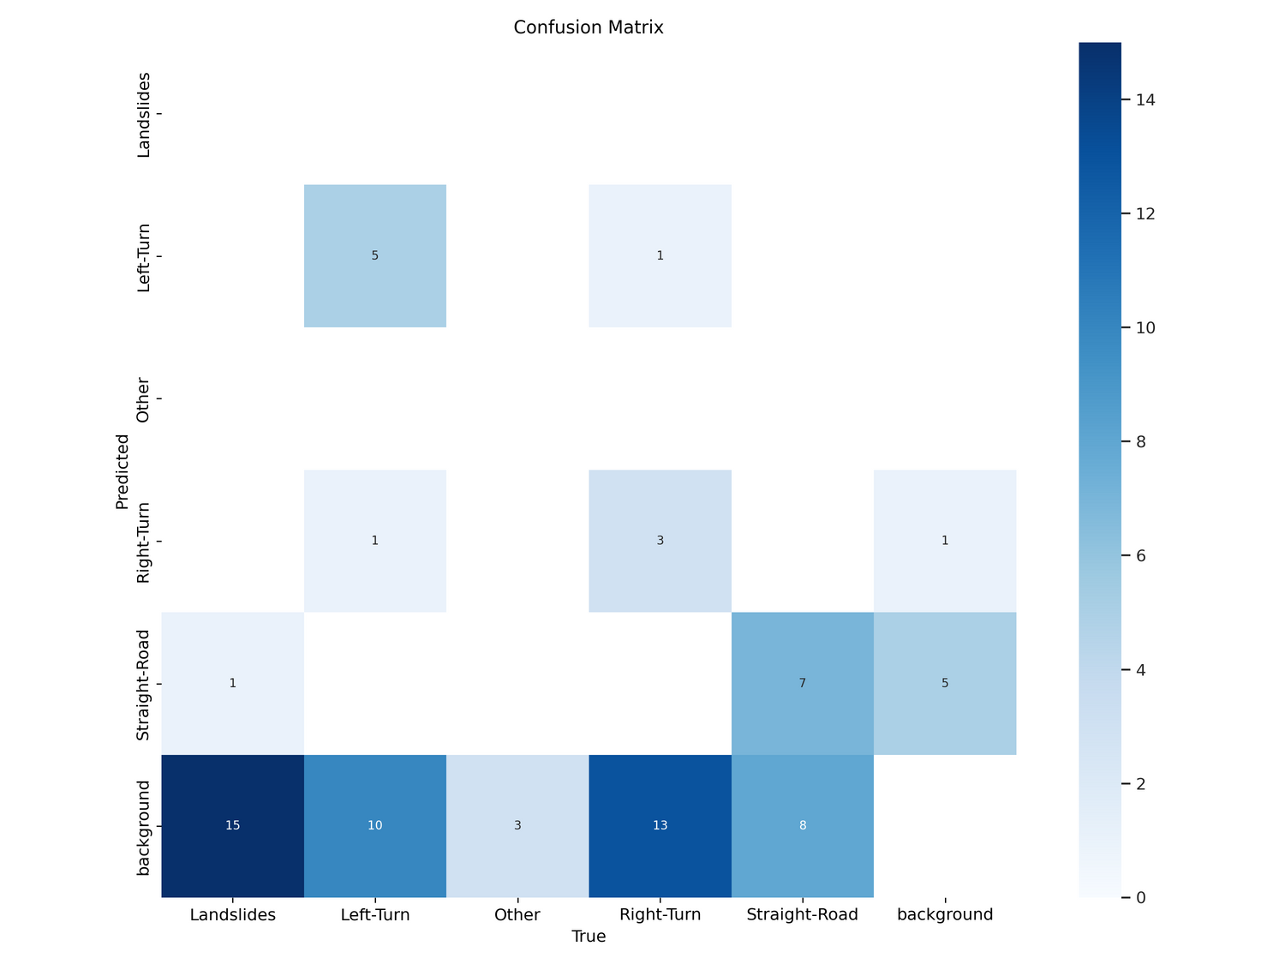
2. Confusion Matrix
The confusion matrix illustrates the model's performance in classifying different road conditions. The matrix includes five classes: Landslides, Left-Turn, Other, Right-Turn, Straight-Road, and Background.

Slide 8
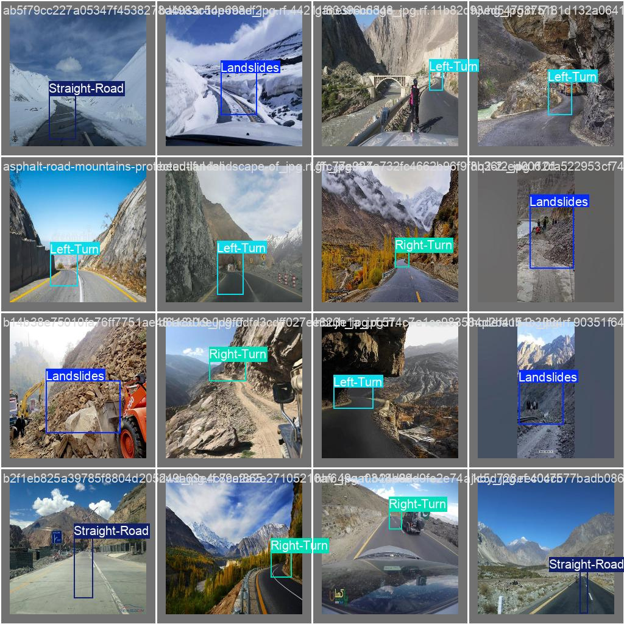
3. Example Visualizations
To assess model performance visually, we ran the trained model on test images.

Slide 9


Thank YOu

